Slide 1
AEC Project: Intermediate Evaluation
Prepared by: Meet Gera and Soumil Gupta

Slide 2
Content
Low Pass Filter
Mixer (Switch) Circuit
Quadrature Oscillator

Slide 3
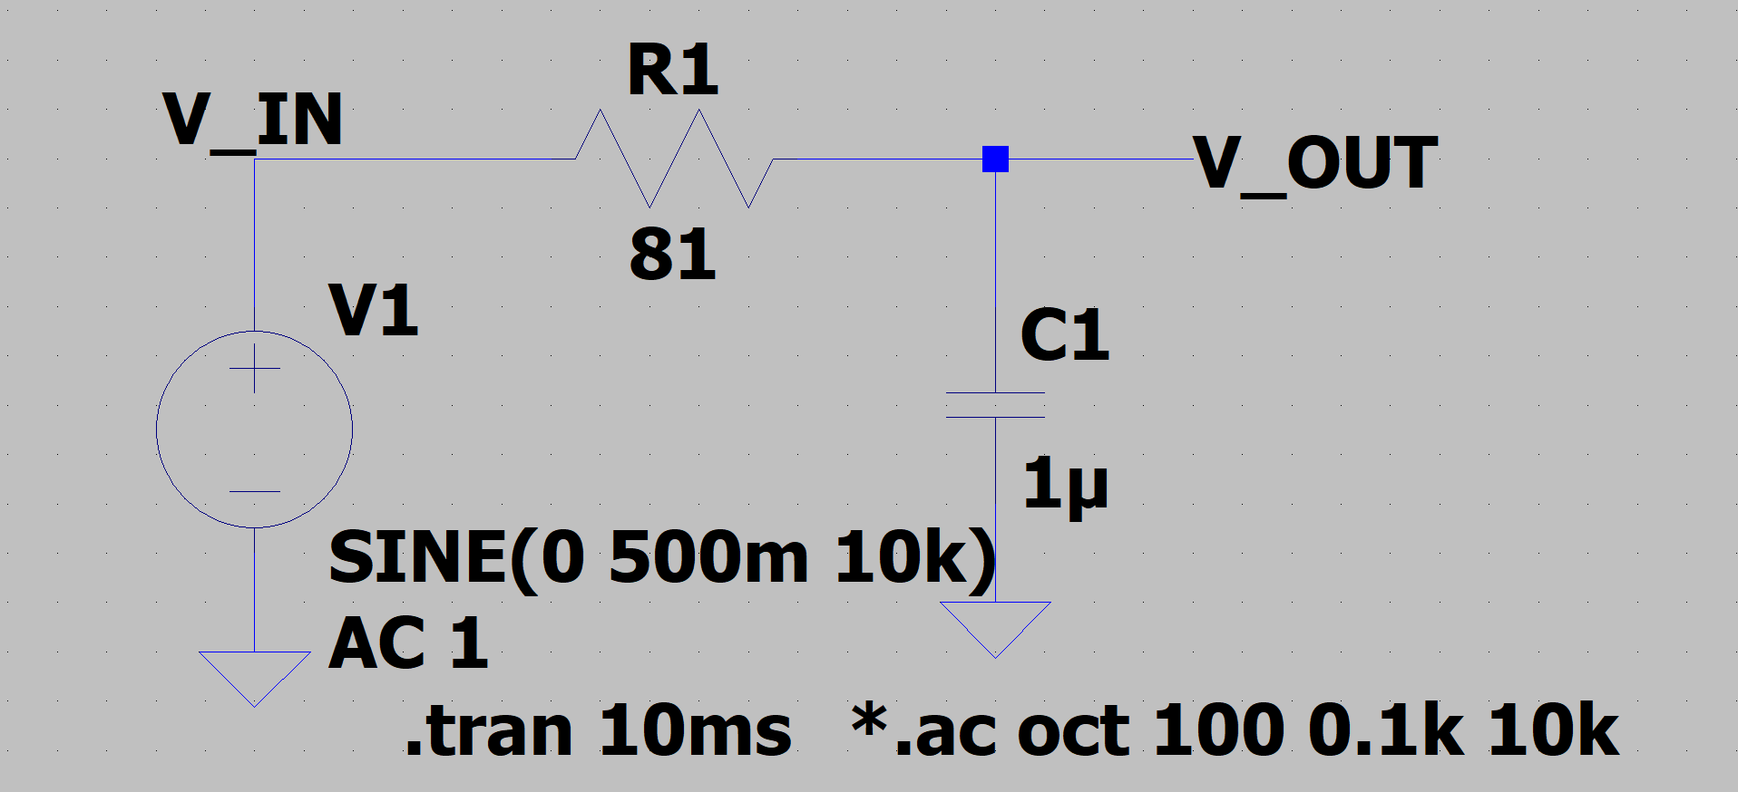
Low Pass Filter
LT-Spice Schematic:

Slide 4
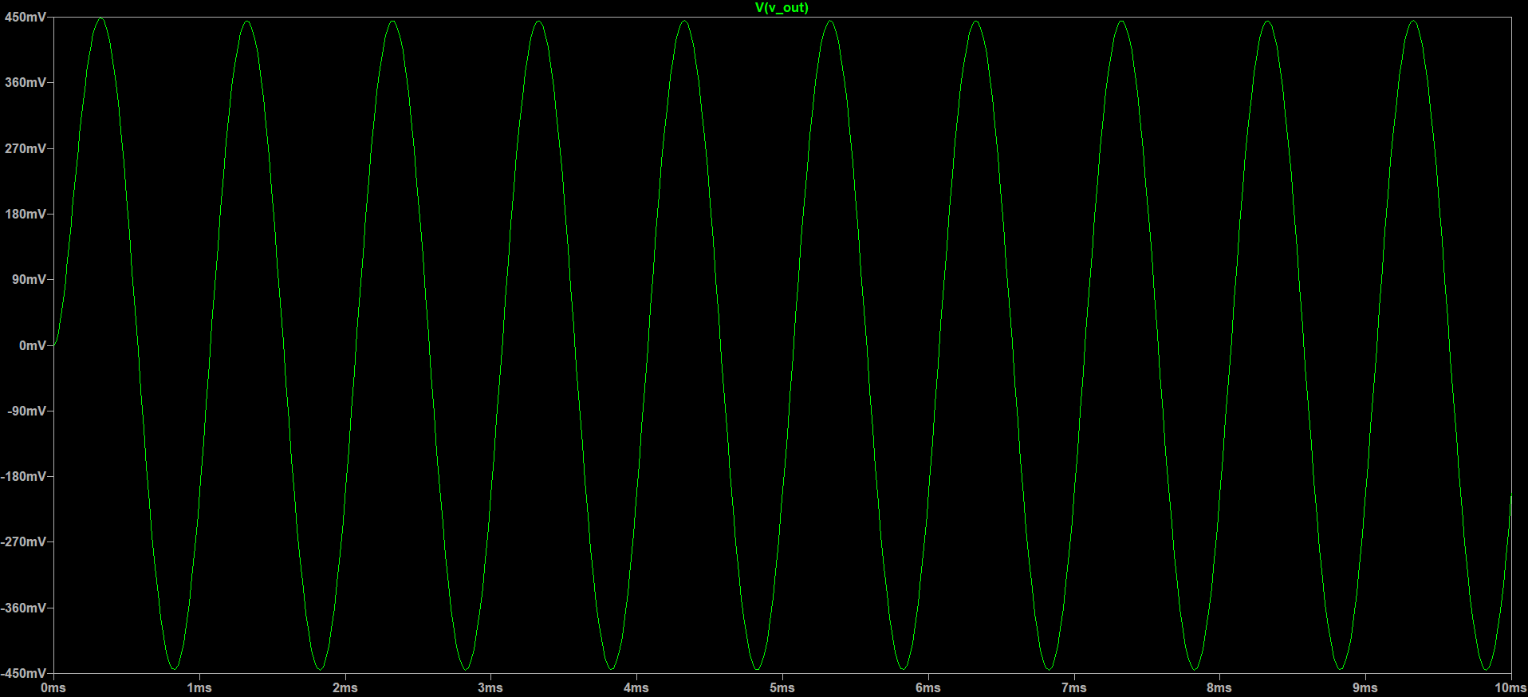
Low Pass Filter
Transient Response for 1KHz Input signal:

Slide 5
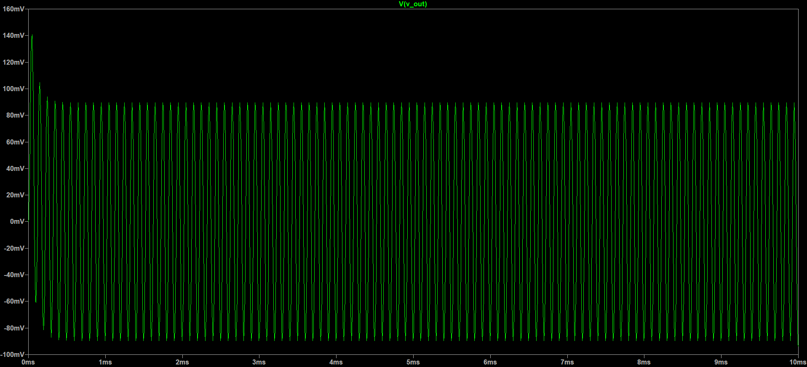
Low Pass Filter
Transient Response for 10KHz Input signal:

Slide 6
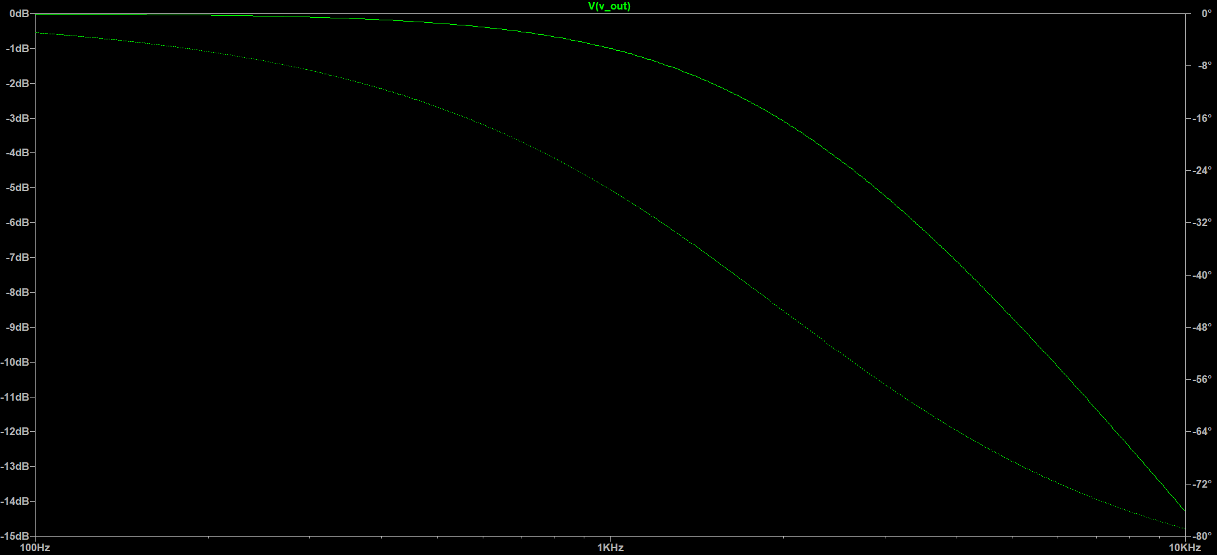
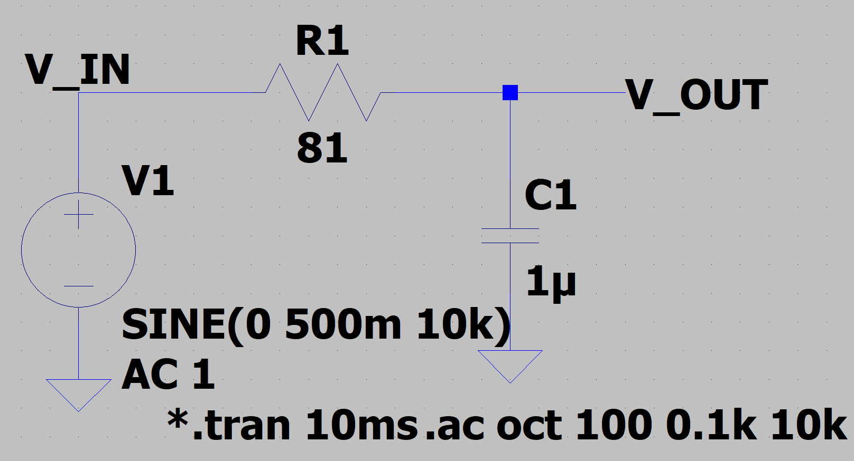
Low Pass Filter
Frequency Response:

Slide 7
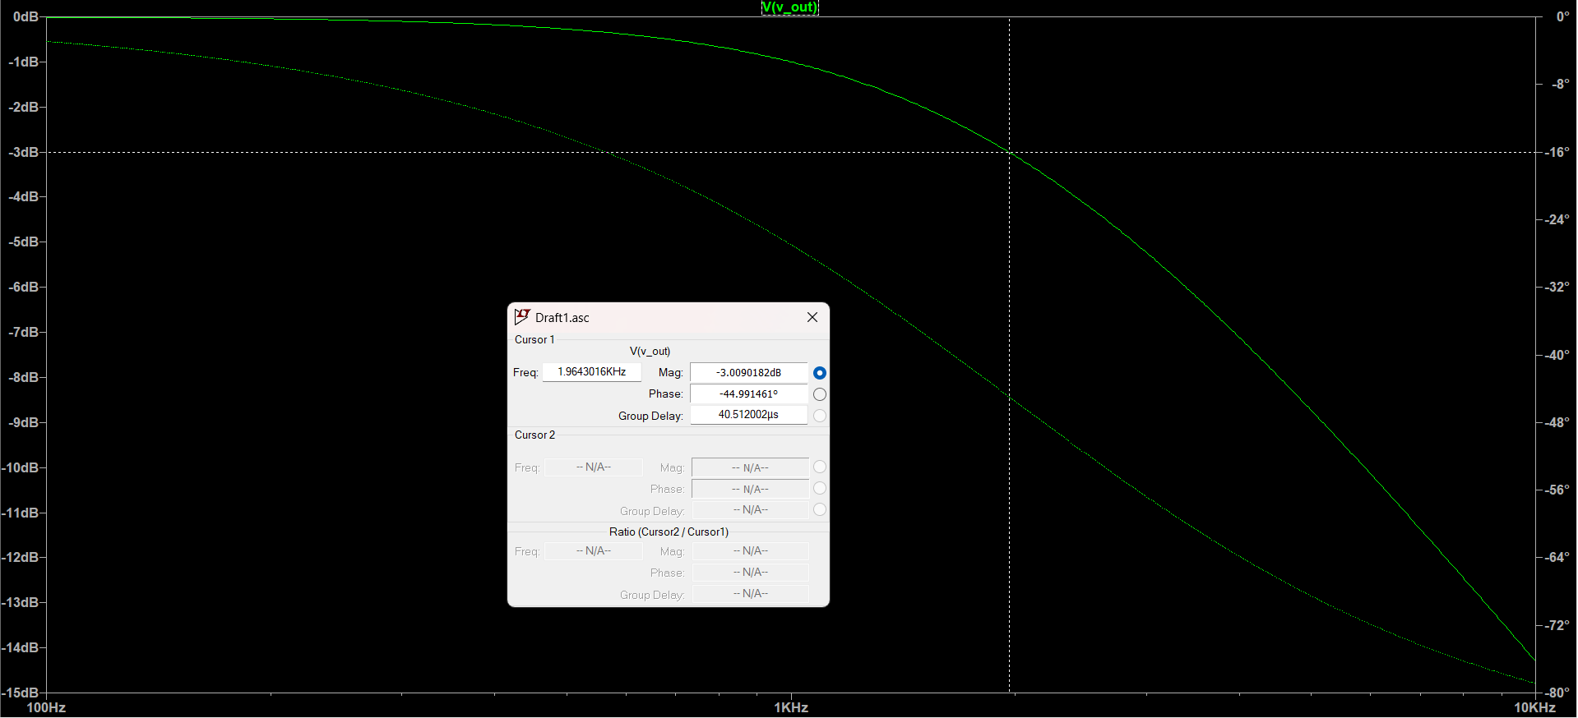
Low Pass Filter
-3dB cut-off frequency: 2kHz

Slide 8
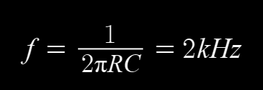


Low Pass Filter
Calculations:
We took the following values:

Slide 9
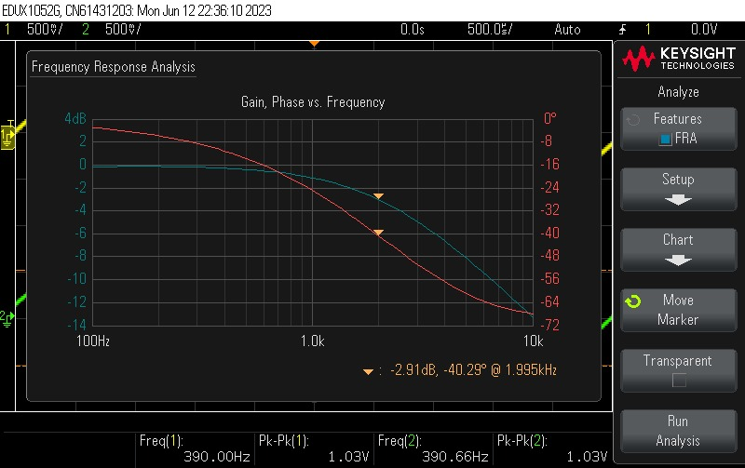
Low Pass Filter Lab Results→

Slide 10
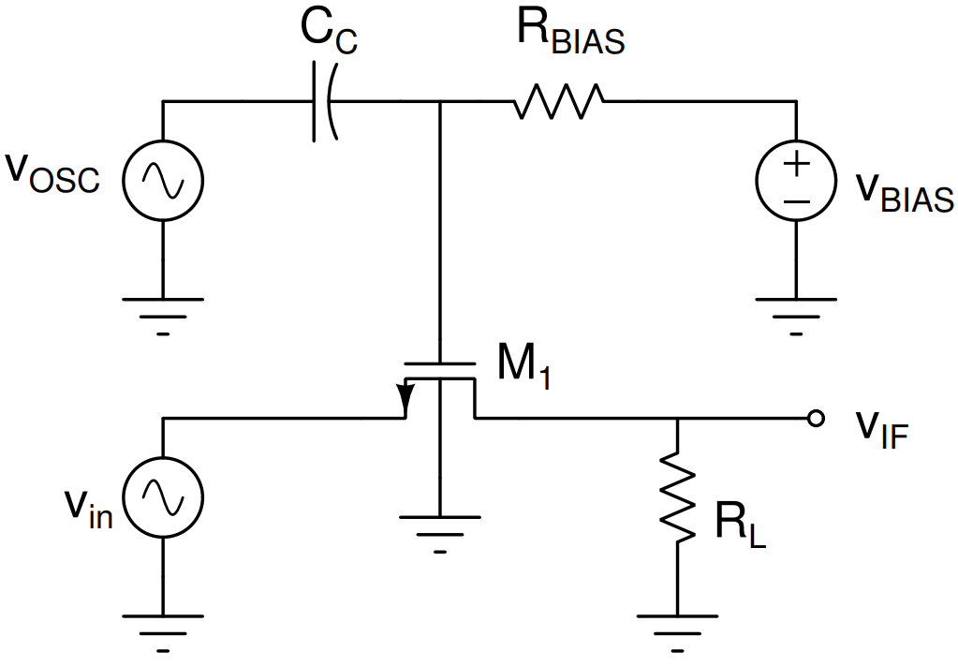
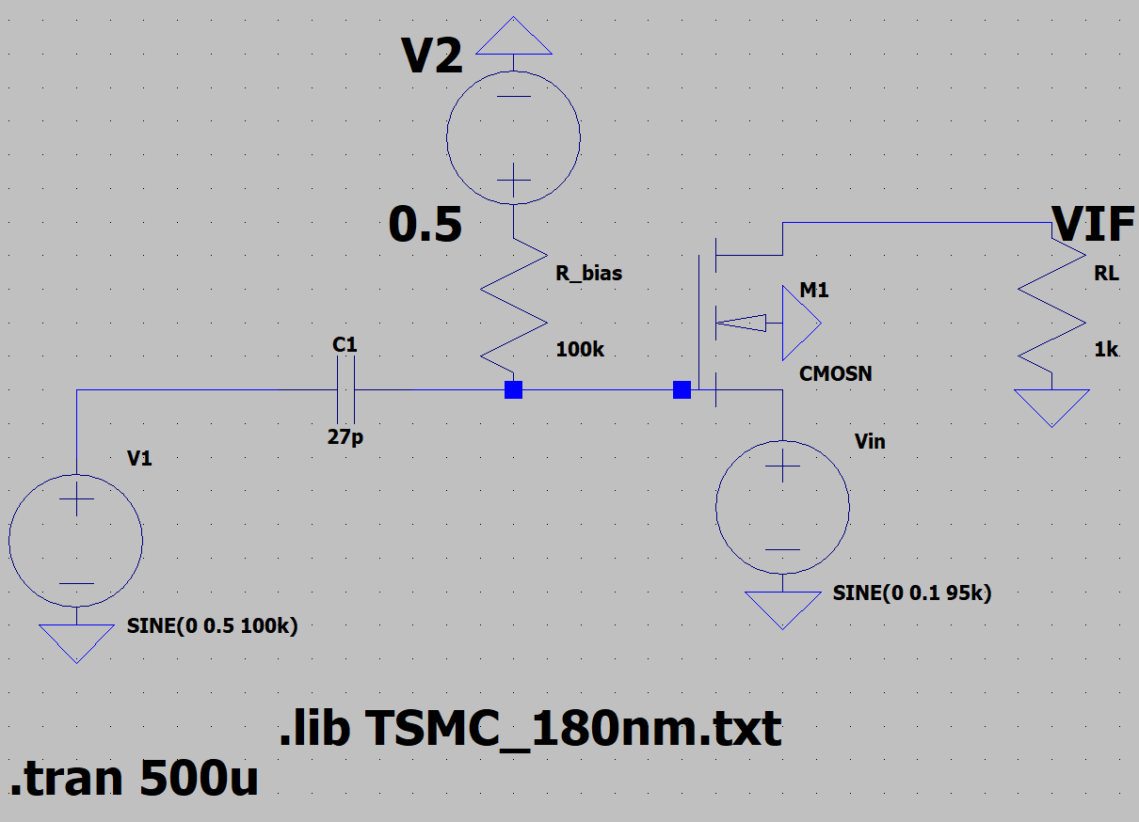
Mixer (Switch) Circuit:
Circuit Diagram: LT-Spice:

Slide 11
Mixer (Switch) Circuit:
MOSFET Parameters chosen:
L = 0.18u
W = 1.8u
AS = 0.81p
AD = 0.81p
PS= 4.5u
PD = 4.5u
Calculations:
In the circuit we have Rbias, Cbias and RL.
To prevent DC current from flowing into the AC Source, we add a coupling capacitor Cbias to the circuit. The coupling capacitor prevents the flow. We can take any small value of capacitance, we went with 27pF
To prevent AC current from flowing into the DC Source, we add a very high resistance Rbias to increase the impedance, which prevents the above. We can take any high value of resistance, we went with 100k Ohm

Slide 12
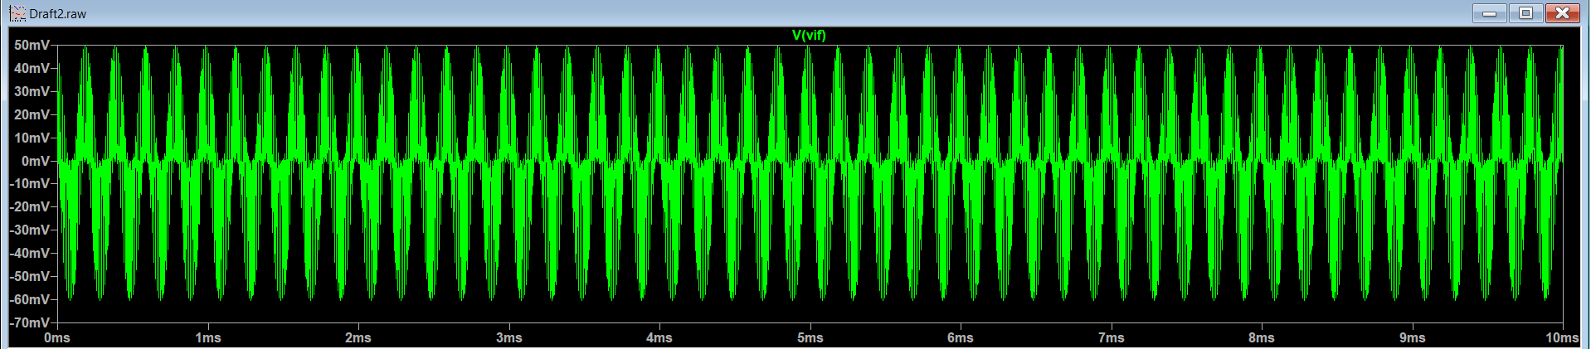
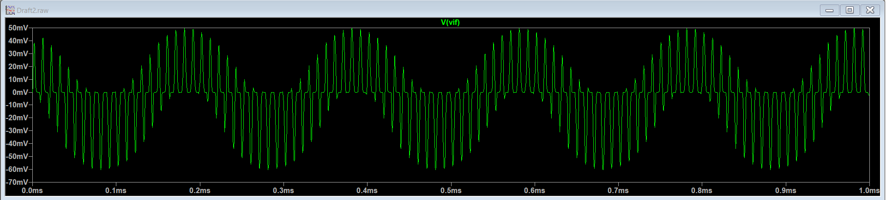
Transient Response:

Slide 13
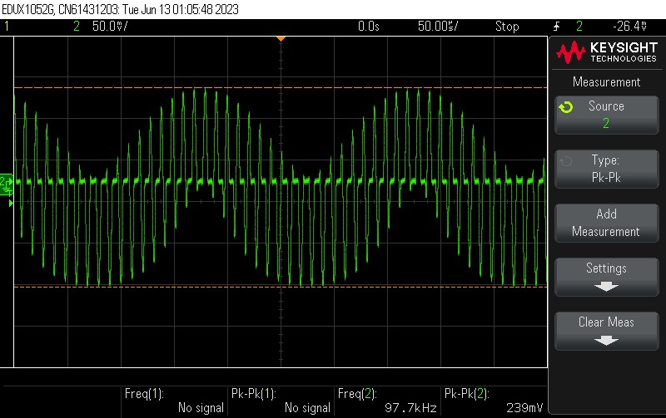
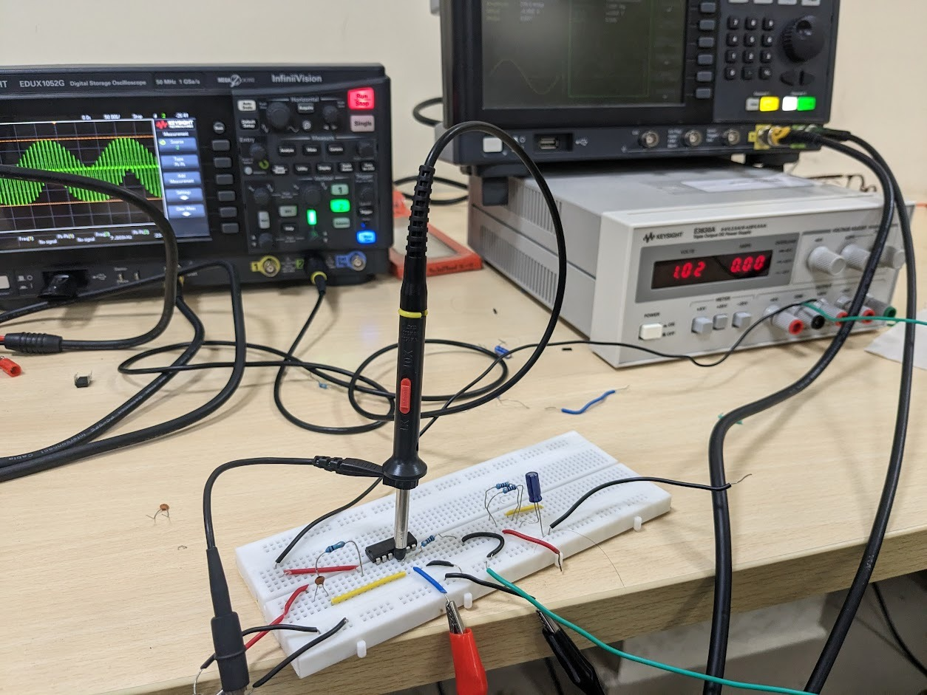
Lab Results→

Slide 14
Lab Results→

Slide 15
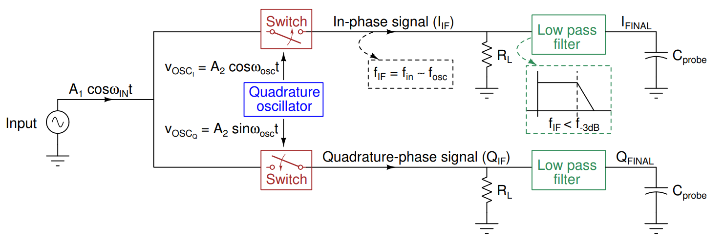
The Quadrature Oscillator

Slide 16
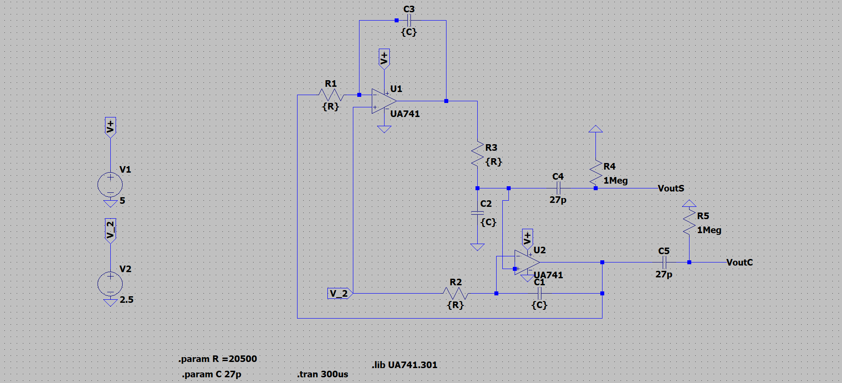
The Quadrature Oscillator
LT-Spice:

Slide 17
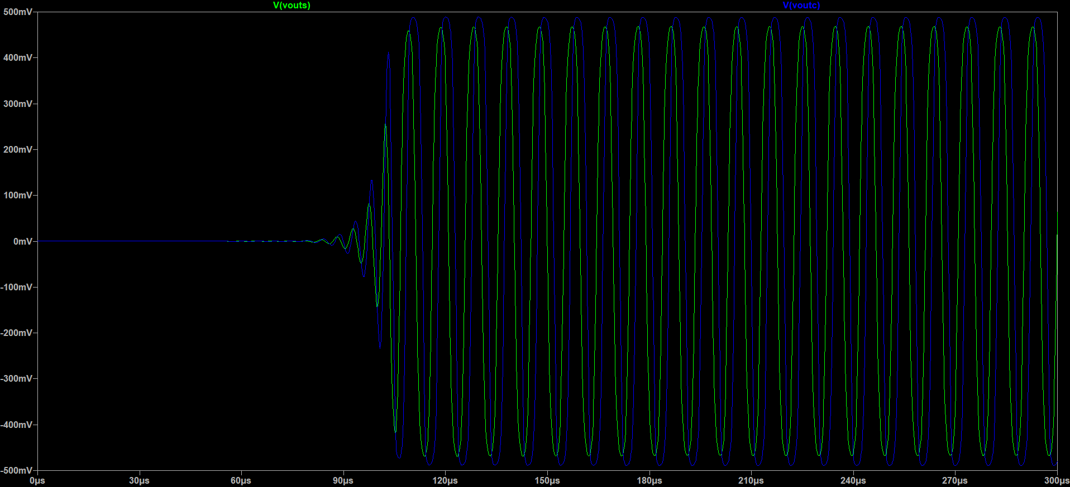
The Quadrature Oscillator
LT-Spice Output Plot:

